Slide 1

BILKENT COMPANION
6 BUGZ(2F)
Sahra Karakoç, Elif Kurtay, Cansu Moran, Öykü Irmak Hatipoğlu, Atakan Dönmez, Yusuf Ardahan Doğru

Slide 2
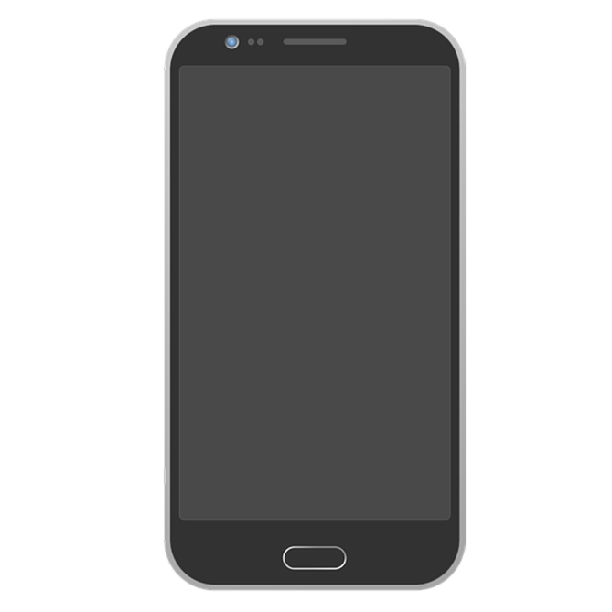

«One Platform to Rule Them All»
As Bilkent students, our main goal is to develop a mobile phone application that will solve some of our daily problems in Bilkent University by collecting all the needed and wanted features in one app.

Slide 3

We got 99 problems and Bilkent is one of them.
All the Bilkent platforms are scattered across the Internet and students try to use these platforms to sell and buy things, especially books and search for their lost items/return some found objects.

Slide 4

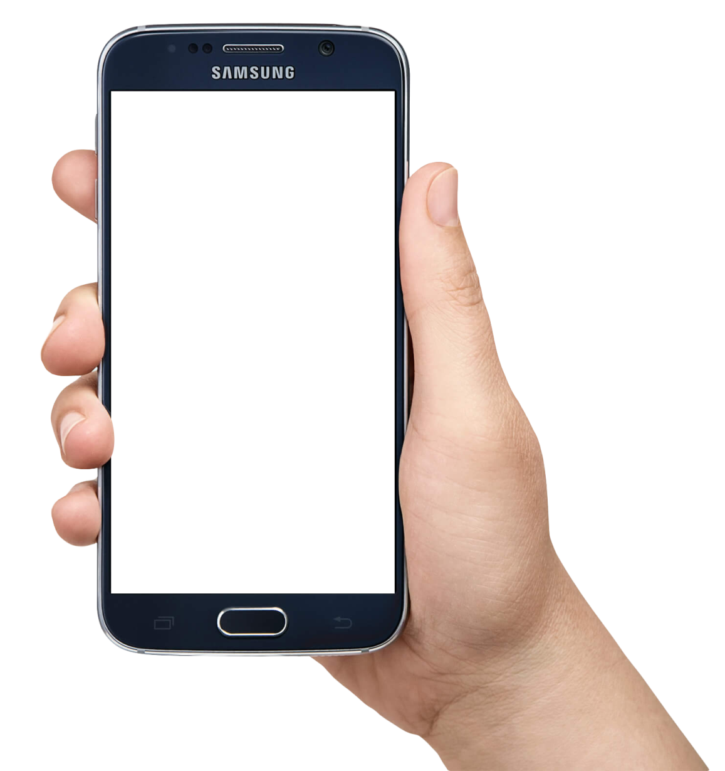
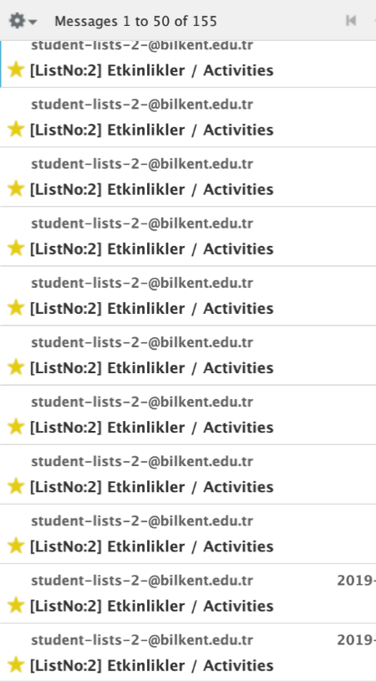
Club Activity Announcements
Every day our mail accounts get bombarded with activities e-mails yet not much people check them.

Slide 5


Transportation
For new students, it is hard to locate where the bus stops are.
Bilkent is hard to reach transportation wise.

Slide 6
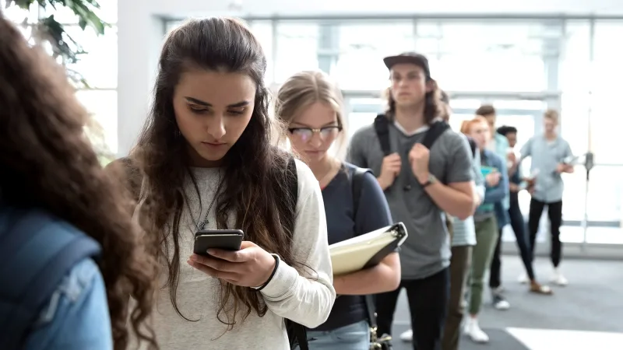
Daily Menu
It’s a bit trouble to check the website everyday
Students don’t check the daily menu beforehand, causing a chaos in the cafeteria

Slide 7
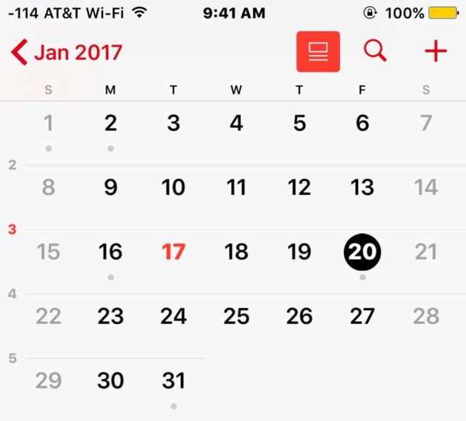
Schedule
Hard to see which activities match with your program and which do not.

Slide 8
Our application…
Sell/Buy & Lost/Found Forum
Allows user to give advirtesementsand send each other messages on a specific advertisement
Transportation
Contains bus schedules and a map showing bus stops
Daily Menu
Updates when weekly menu is available
Allows user to choose favourite meal and sends notification
Club Announcements
Allows club members to post upcoming events
Sends notification for the selected clubs/types of events or
Personal Calendar
Allows user to import schedule and may send notifications
Checks whether an event suits the schedule

Slide 9

Details
Mobile phone application(android)
Available to multiple users
Personal accounts created with ID numbers and password(chosen by the user)
Simple user interface
Clear categories (Forum, Transportation...)
Sub-categories (Forum -> Found -> Book)
Notifications for followed items, entries, favorite meals, upcoming activities etc.
Notifications can be muted(one by one or all together)

Slide 10

Thank you for listening!

